Slide 1
Proposed
2025 Mission & Ministry Budget
The Episcopal Diocese of North Carolina

Slide 2
Find the budget at
episdionc.org/annual-convention.
Find the 2022 and 2023 full audited statements at
episdionc.org/administration-finance-resources.
Notes:
Please note that the complete two-year comparative diocesan budgets for 2024 and the proposed 2025 budget can be found on the website mentioned in this slide. I encourage you to visit this section so you can follow along with the figures I will present after the video.
As delegates of the convention, you hold the responsibility of assessing whether the proposed budget aligns with the diocesian mission strategies. The council is tasked with overseeing the review and execution of actual spending in accordance with the budget approved by the convention.
Council meetings take place monthly to evaluate real-time financial data and manage the collection and allocation of funds. This is why year-to-date figures are not included in this budget presentation. For complete transparency, you can access the full audited financial statements for 2022 and 2023 at episdionc.org.
After I go through the slides we will have time for any questions you might have.

Slide 3
Supporting
Congregational Vitality
$1.25 million discipleship grant
Support for intergenerational worship and formation in local congregations
Church mini-grants for children’s formation
Salary for missioner for children’s and family ministry
Mission Proceeds Disbursement
Phase I: $3 million for churches with an annual operating budget <$100,000 and historically Black and Latino congregations
Phase II: $1 million for collaborative mission strategy projects
Phase III: $1 million unrestricted funds
Notes:
Let’s begin
The 2025 Mission & Ministry budget is especially focused on congregational vitality, which is also the theme of the 209th Annual Convention. Vitality does not mean only budget or ASA. Instead, vitality appears in many different ways in different contexts. A congregation might exhibit vitality through the energy of its lay and ordained leaders, through ministries in the local community, or through faithfulness to God’s call.
The 2025 budget seeks to support that vitality wherever and however it appears. The proposed 2025 budget includes two major new sources of income that will directly support churches: a $1.25 million dollar discipleship grant from Lilly Endowment Inc. and $5 million in grants to churches from the building sale proceeds.
The 1.25 Million dollar Lilly grant will enhance intergenerational worship and formation in local congregations, funded by the Lilly Endowment’s initiative to engage children in worship and prayer. Instead of focusing solely on diocesan programs, the diocese will inspire congregations to explore inclusive worship and holistic Christian formation, connecting congregations and equipping leaders to create sensory-rich worship rooted in Episcopal traditions.
Over five years, strategies will include coaching for assessing children’s involvement in worship, mini-grants for innovative engagement experiments, gatherings to foster community practices, learning opportunities for leaders, and hiring a missioner for children’s and family ministry to oversee the grant and strengthen relationships.
The second major new source of income is the distribution from the sale of the diocesian office building.
200 W. Morgan St property was sold for $9.1 Million in 2023, yielding net proceeds of $8.8 million. $3.8 million has been set aside to be invested. The interest generated from this investment will be utilized to cover the lease cost for the new diocesan office location. The approach ensures that the lease costs are sustainably managed through investment returns. A Mission Proceeds Task Force was created to recommend the best use for the remaining $5 million.
The distribution of these funds is a fresh stat in our work with congregations laying the ground work for rebuilding relationship and trust. The $3 million in Phase 1 for congregations with an annual operating budget of less than $100,000, as well as historically Black and Latino congregations. Those funds will support 25 churches in their ongoing, vital work among their congregations and communities. We look forward to announcing the Phase 1 grant recipients soon.
Phases II and III are scheduled for distribution in 2025, with further details to follow. These phases will be available to all congregations within the diocese.
It’s important to highlight that this additional $6.25 million in new funding, designated for congregational vitality, is not included in the 2025 proposed budget. These funds represent initiatives that go beyond what is outlined in the proposed budget.

Slide 4
Supporting
Congregational Vitality
2025 Diocesan Fair Share: 10.65%
Steadily decreasing since first implemented at 12%
Diocesan Council has recommended a proposed reduction of the 2026 fair share rate to 10.55%
The lowest the fair share can go according to the canons is 10%
Episcopal Church assessment: 15%
Notes:
2025 Diocesan Fair Share: 10.65%
This rate has steadily decreased from the initial 12%. The Diocesan Council has recommended a further reduction of the fair share rate to 10.55% for 2026.
According to the canons, the fair share cannot drop below 10%. For comparison, the Episcopal Church assessment stands at 15%.

Slide 5
Churches Helping Churches -
“Tied in Salvation with one another”
Finance and Audit Team -Churches Helping Churches
This group supports smaller to mid-sized congregations in filing their parochial and audit report
Dedicated volunteers from across the diocese all committed to helping fellow congregations thrive
Planning Department
This is a department of council formed to assist with complex building issues
Group of volunteers who have assisted in strategic decision-making and discussions guiding congregations through important facility-related challenges
Notes:
Another two efforts established to support Congregational vitality is the Fianance and Audit team and the Planning departmet.
These two efforts although newly formed have already had a positive impact in building relationships between churhces and the appreciation for one another. By focusing on collaboration and shared values, this diocese can navigate challenges together, embodying the spirit of being "Tied in Salvation."
Finance and Audit Team – Churches Helping Churches is a group of volunteers around the diocese with time and talent in assisting small to mid sized churches file their parochial and audit reports. They also can assist in designing a financial reporting internal controls that better serve the congregation.
The Planning Department is a departement of council but also is made up of volunteers around the diocese to asist churches in complex building issues as well as strategicdecsion making and guilding congregations through important facilty related challenges.
Coming soon is the Junior Warden Team—a collaboration of volunteers from across the diocese aimed at fostering the spirit of "Churches Helping Churches". This initiative will provide support for complex building issues and facilitate the sharing of contractor information and advice among congregations. If you have time and talent in this area and would like to volunteer on the diocesian level to help churches all over the diocese please contact me via email. We would love to have you. We will be rolling this out in 2026.
Next, we’ll watch a brief 10-minute video detailing each department of the budget and its specific role. After the video I’ll take some time to review the detailed figures, focusing on income, expenses, and grants.

Slide 6
Video

Slide 7
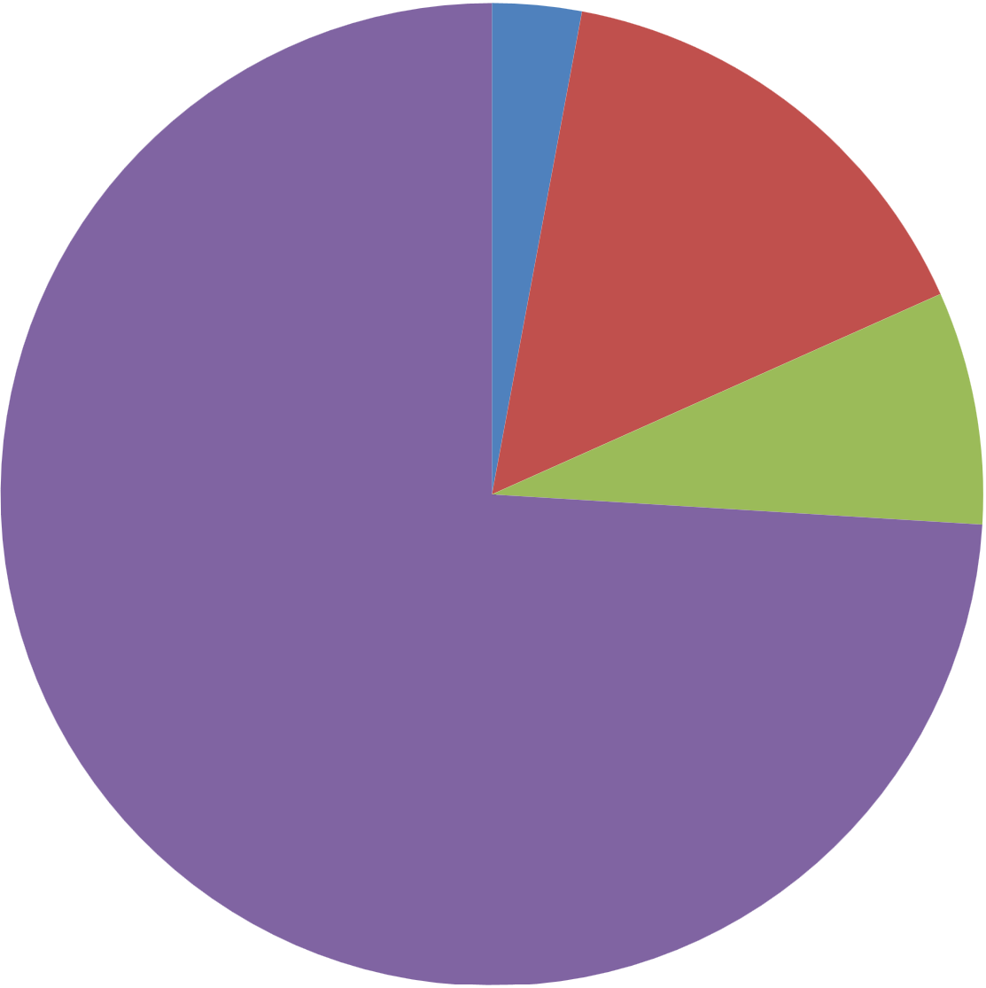
Program Revenue
$206,420
3%
Endowment
Funding
$1,080,360
15%
Income
Fair Share Apportionment
$5,201,441
74%
Restricted Reserves
$538,389
8%
Notes:
Now that we have a clear understanding of how the budget is constructed, let’s examine the income side.
Ther Fair Share rate is currently 10.65% of the operating income calculated from the parochial report. This represents 74% of the diocesan budget. We will explore the various uses of these funds in the expenses slide.
8% of the budget is allocated to Restricted Reserves, which include the Group Insurance Fund for retirement benefits, as well as Rent and Property Reserves.
15 % of the budget consists of Endowment Reserves, supporting Mission Strategy, MRST, NCECF, Parish Grants, and the education of clergy and lay leaders in the diocese.
And additionally, 3% of the budget comes from Program Revenue, which includes registration fees for the Convention and Youth Events. These are additions to revenue but are not meant to create a profit they are offsets to missional costs for these events with the majority of the cost still supported by the budget.
In the next few slides, I will provide a more detailed overview of how these income components work together to support the diocese as a whole.

Slide 8
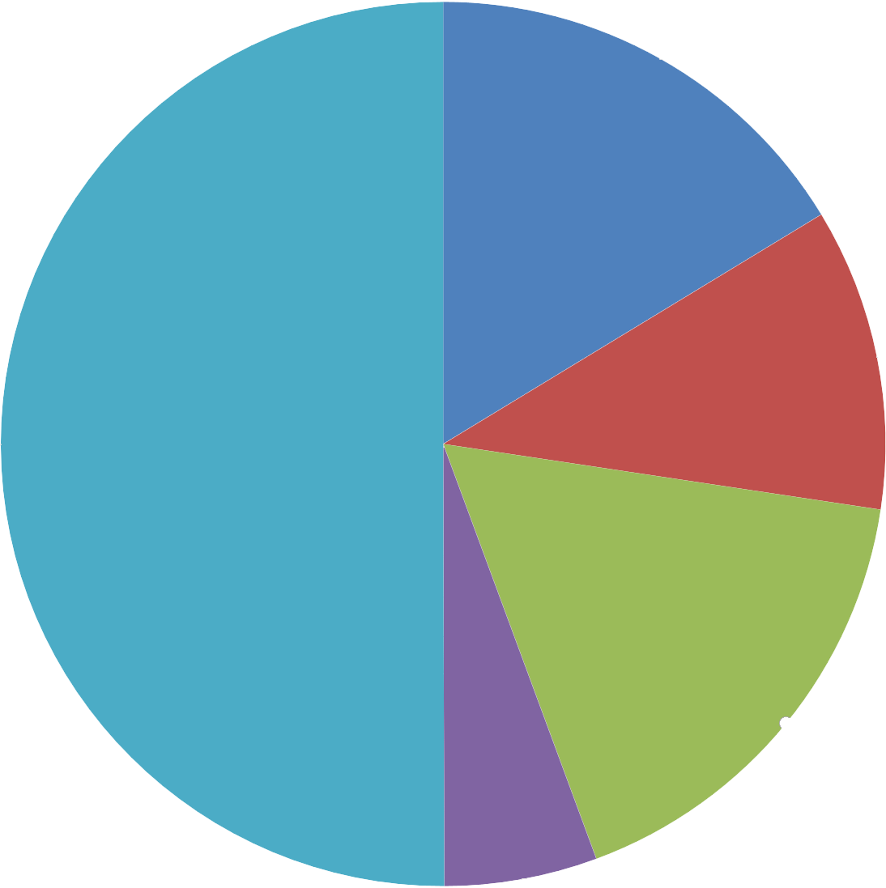
Group Insurance Reserves
$179,000
11%
Racial Reckoning, Justice & Healing Education
$264,084
16%
Endowment Funds
Collaboration & New Communities
$810,000
50%
Building Reserves
$275,165
17%
Educational
Endowment
$90,500
6%
Notes:
Let’s talk more about the endowment funds that make up 15% of the proposed 2025 budget.
The "Collaboration & New Communities" segment of our funding graph encompasses 50% of the endowments used these contributions come from the Mission Strategy, the North Carolina Episcopal Church Foundation (NCECF), Parish Grants, and MRST endowment funding. These endowments were set up and created with the intention to distribute grants to congregations throughout the diocese, and you can find more information on the grants page of our diocesan website.
By pooling these funding sources we created the Sustainabilty Fund to support clergy leadership in historically Black and Latino congregations that have been underserved in the past with a 5 year grant that started in 2022.
16% represtents "Racial Reckoning, Justice & Healing" initiative includes funds from endowments dedicated to the education and training of both clergy and lay leaders in the diocese of North Carolina. This funding reinforces our mission strategies, fostering a sense of communion among us.
17% "Building Reserve" consists of funds from the sale of the property at 200 W. Morgan, with the earnings allocated to cover the expenses of our new diocesan offices located on Six Forks Road.
This strategic allocation of endowmnt resources ensures that all areas of the diocese remain sustainable while kepping Comgregational support always at center of our priorities.

Slide 9
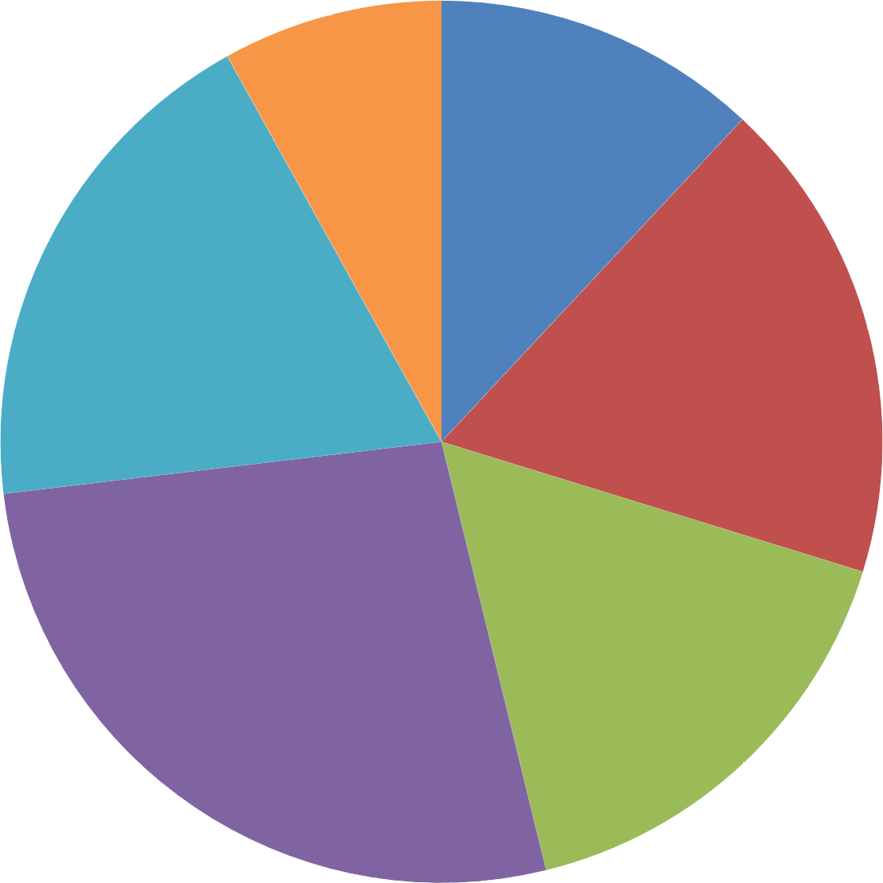
Missional Collaboratives
$567,136
8%
Oversight
$839,966
12%
Formation
$1,321,705
19%
Governance
$1,251,466
18%
Expenses
(Gross; before netting reserve and endowment funds)
Congregational Support
$1,892,507
27%
Administration
$1,153,830
16%
Notes:
Now let’s look at the expense side of the budget, arranged based on the mission strategy priorities. Each section of the budget, while varied in focus, ultimately supports the diocesian mission.
Expense Budget Breakdown
Congregational Support (27%)
Description: This is the largest section of the budget, focusing on resources and support for local congregations.
Includes:
Canon missioners
Transition ministry department
Missional support initiatives
Impact: Empowers congregations to thrive, offering them necessary tools and resources to fulfill their missions.
Oversight (12%)
Description: Encompasses all expenses related to the bishop's office, ensuring effective leadership and guidance.
Includes:
Bishop’s office operations
Support for diocesan leadership initiatives
Impact: Provides strong spiritual and administrative leadership, fostering unity and vision across the diocese.
Governance (18%)
Description: Covers expenses tied to the organizational structure and operations of the diocese.
Includes:
Diocesan convention costs
Diocesan archives maintenance
Annual Episcopal Church assessment
Impact: Ensures proper governance and accountability, maintaining historical records and fulfilling obligations to the wider church.
Administration (16%)
Description: Includes costs associated with the daily operations of the diocesan office.
Includes:
Building expenses
Finance department operations
Communications department costs
Impact: Aministration Facilitates the efficient running of the diocese, allowing for effective communication and financial stewardship. Finance and communications department employees also work directly with clergy and lay staff and leaders to support their churches’ finance and communications needs.
Formation (19%)
Description: Focuses on educational and formation initiatives across the diocese.
Includes:
Support for 10 campus ministries
Adult, intergenerational, and youth formation programs
Impact: Nurtures spiritual growth and engagement among all age groups, promoting lifelong discipleship.
Missional Collaboratives (8%)
Description: Addresses various outreach and justice initiatives within the diocese.
Includes:
Racial reckoning and justice initiatives
Missional strategy initiatives
Impact: Engages congregations in social justice, fostering a sense of mission beyond the church walls.
Conclusion
Its important to point out that Each section of your budget plays a vital role in advancing the diocesian mission and supporting congregational life. The purpose and impact of each area, reinforces the interconnectedness of all efforts in achieving the shared goals of our diocese. This holistic approach is what strengthens the diocese and its communities to face complex challenges together.

Slide 10
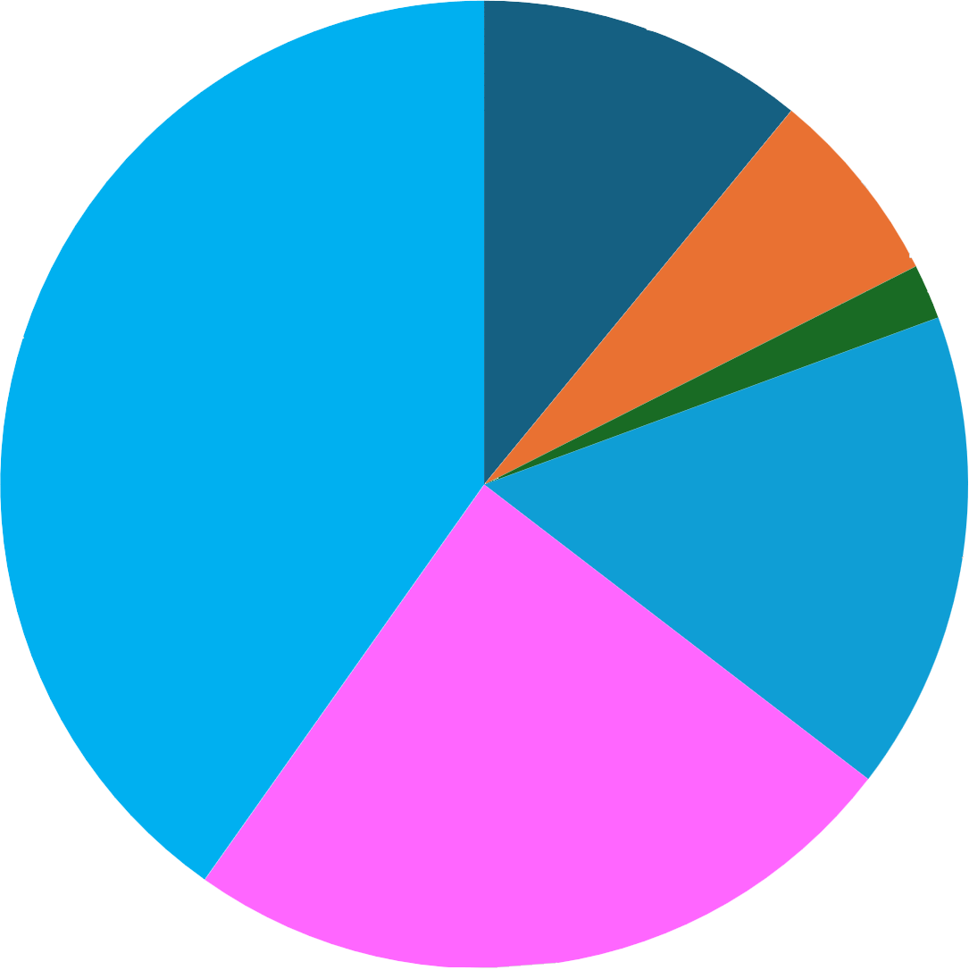
Racial Reckoning, Justice & Healing
$502,682
11%
Buildings
$303,062
7%
Collaboration & New Communities
$1,845,684
40%
Grants
(Totals disbursement, 2020-2023)
Reimagining Curacies
$735,551
16%
Clergy & Lay Support
$1,119,684
24%
Creation Care
$84,489
2%
Notes:
At the beginning of our presentation, we highlighted two exciting new funding sources designed to enhance congregational vitality. However, these are just part of the broader array of grants available to churches in the Diocese of North Carolina.
From 2020 to 2023, the diocese distributed nearly $4.6 million in grants to support our congregations.From 2020 to 2023, the Diocese disbursed nearly $4.6 million in grants to support various church initiatives.
The "Collaboration and New Communities" segment of our funding breakdown includes sustainability grants, mission endowment funds, and grants from the North Carolina Episcopal Church Foundation and the MRST.
The "Clergy and Lay Support" segment encompasses seminarian grants, new curate hire grants, and funding for clergy and lay wellness programs.
Additionally, the "Reimagining Curacies" initiative is supported by a grant from Lilly Endowment Inc. and and matching diocesian funding
Our efforts toward racial reckoning, justice, and healing are backed by grants from the mission endowment, while the Building Grants are funded by the North Carolina Episcopal Church Foundation in collaboration with the planning department of Diocesan Council.
Lastly, Creation Care Grants are made possible through the North Carolina Episcopal Church Foundation's green grants program.

Slide 11
Supporting
Congregational Vitality
In summary, congregational vitality remains at the heart of our diocesan missional priorities
$1.25 million discipleship grant
$1 million Reimagining Curacies grant began in 2021
$5 million in mission proceeds grants
Diocesan Council has recommended a proposed reduction of the 2026 fair share rate to 10.55%
$1 million in funding annually from the mission funders and missional donor directed endowments
$4.6 million in mission grant funding distributd since 2022
Notes:
In summary the diocese has been proactively addressing its challenges through several key initiatives. We are actively seeking external grants and have increased grant funding to the congregations to strategically offset the pandemic's impact as congregations continue to recover.
Outside grant funding secured includes the $1.25 million Discipleship grant and $1 million reimagining curacy grant started in 2021 and recently placed two new curates in 2024.
The diocesan funders have been committed to supporting Congregational Vitality by distributing $4.6 million in mission grant funding and donor directed endowment funding since 2022. These efforts collectively enhance our ability to serve and uplift our communities.
A significant amount of this funding has been used to supporting underserved communities by establishing the 5 year Sustainably Fund grant, which pools resources from mission funders to support clergy salaries in historically Black and Latino congregations. This initiative was aimed to ensure equitable compensation and bolster leadership in these vital communities. This grant funding began in 2022.
Together, these funding sources empower our churches to thrive and fulfill their mission in meaningful ways.
Congregational vitality is the culmination of many collaborative efforts. When your congregation contributes its fair share you can be confident that these funds are making a meaningful impact .The diocesan budget reflects how we all contribute to supporting one another—churches uplifting each other and engaging in missional initiatives that extend beyond our own neighborhoods. We are united in communion, working together to make a broader impact in our state and all communities.
This concludes our presentation peace and blessing and please let us know if you have any questions.

